Slide 1
Smart Waste Management System using IoT
May 18, 2024

Slide 2
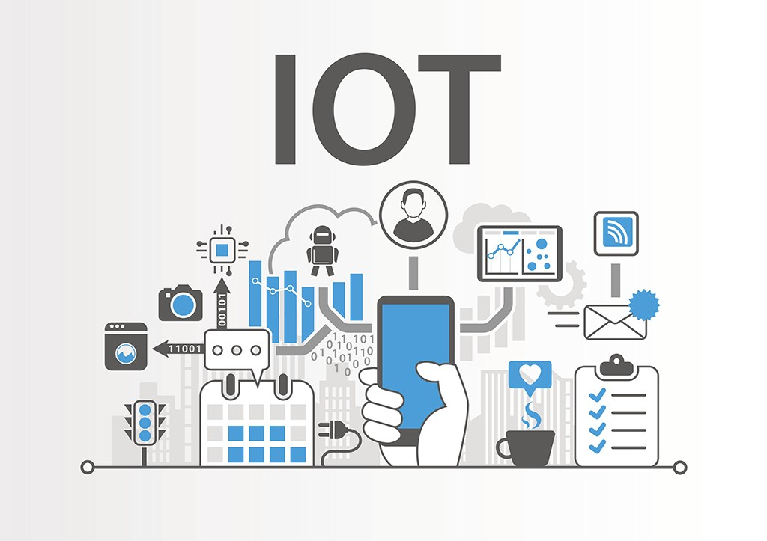
AGENDA
Objective
Hardware Selection and Design
Software Integration and Protocols
Software Design
Integration of End, Edge, and Cloud
Data Accumulation and Processing
IoT Analytics and Outcomes
Conclusion and Future Scope
This Photo by Unknown Author is licensed under CC BY-SA-NC

Slide 3

Objective
The project aims to design and implement a smart waste management system using IoT technology to enhance efficiency, reduce costs, promote sustainability, and utilize data analytics. Specific objectives include real-time monitoring, automatic updates, optimized collection routes, data analysis, and a user-friendly interface.

Slide 4
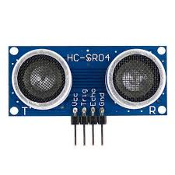
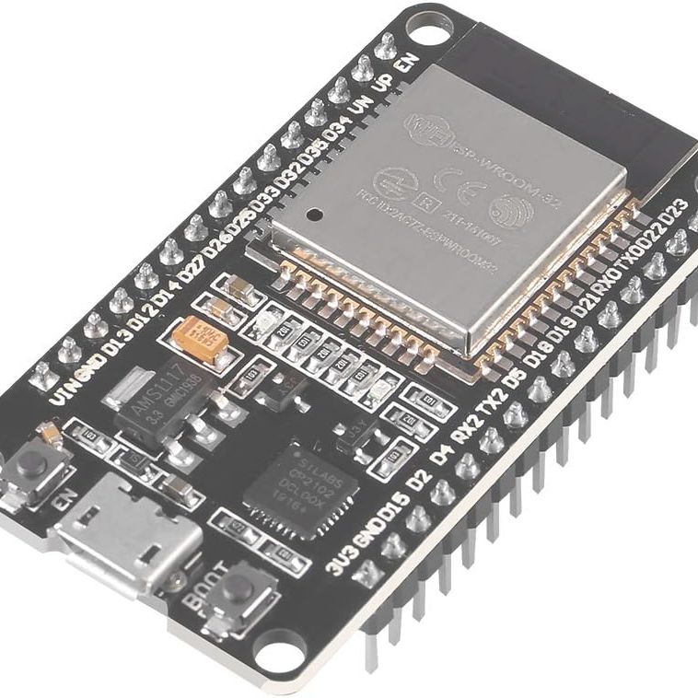
Hardware Selection and Design
Ultrasonic Sensor
End Device - ESP32
Lora Gateway - ESP32
Measures the fill level of waste bins by emitting sound waves and detecting the time it takes for the echo to return, determining the bin's fill level.
Chosen for accuracy, range, and reliability in various environmental conditions.
Positioned inside the waste bin at the top to measure the distance to the waste surface.
Connected to the ultrasonic sensor, collects sensor data, and transmits it using the LoRa communication module.
Equipped with both LoRa and Wi-Fi modules. Receives data from the bin ESP32 via LoRa and uploads it to the cloud through Wi-Fi.

Slide 5
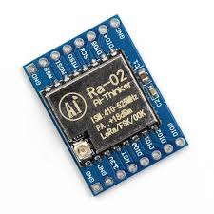
Hardware Selection and Design
Long-Range Communication: LoRa technology enables long-distance communication, making it ideal for transmitting data from waste bins located in remote or hard-to-reach areas to central management systems.
Low Power Consumption: LoRa is designed for low power consumption, allowing sensors to operate for extended periods on battery power, which is crucial for maintaining consistent monitoring in a smart waste management system.
Operates using radio frequency signals, typically at a frequency of 868 MHz (or 915 MHz depending on the region). Selected for reliable communication in urban environments with obstacles.
LoRa
Enables low-power, long-range wireless communication between the ESP32 inside the bin and the gateway ESP32 over considerable distances without direct line of sight.

Slide 6
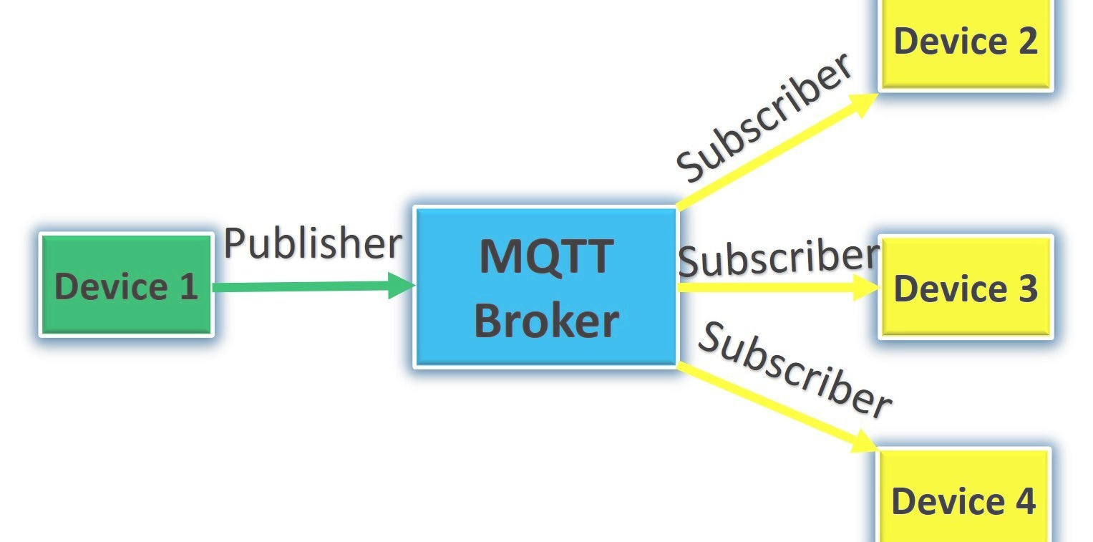
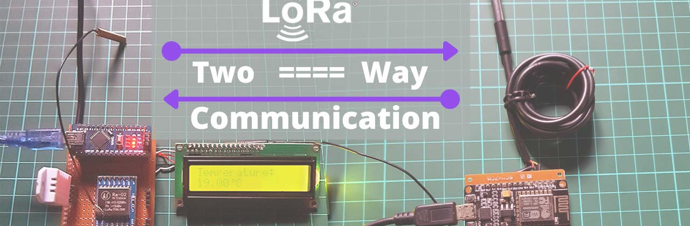
Software Integration and Protocols
MQTT Protocol
LoRa Protocol
Code that integrates MQTT for communication with HiveMQ Cloud, a managed cloud MQTT platform. Utilizes MQTTClient library for connection and interaction with the broker.
LoRa communication is used for local communication between ESP32 devices. Manages wireless communication within the system.

Slide 7
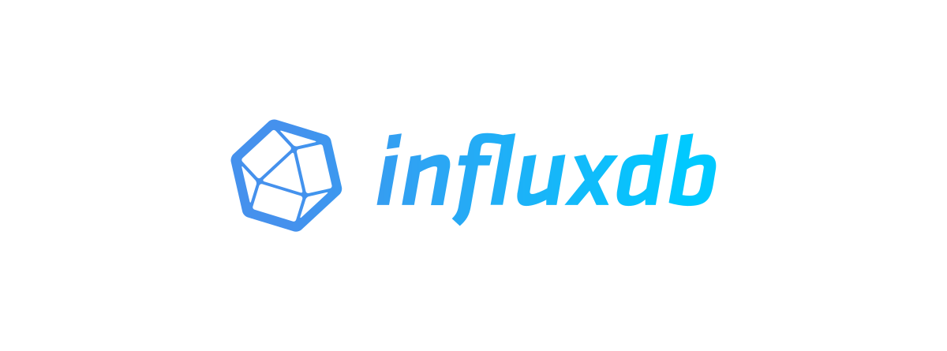

Software Integration and Protocols
Cloud Integration
Time-Series Data Storage: InfluxDB is optimized for handling time-series data, making it ideal for storing continuous sensor readings from IoT devices such as ultrasonic sensors in a smart waste management system.
High Write and Query Performance: InfluxDB supports high write and query throughput, enabling efficient storage and retrieval of large volumes of data generated by numerous IoT sensors in real-time.
Data Retention Policies: InfluxDB allows the creation of data retention policies to automatically manage the lifecycle of the collected sensor data, ensuring that the database remains efficient and cost-effective over time.
The code connects to HiveMQ Cloud, a fully managed cloud MQTT platform, for MQTT communication.
The gateway ESP32 subscribes to these topics and publishes the received data to the HiveMQ Cloud MQTT broker for cloud storage and processing.

Slide 8
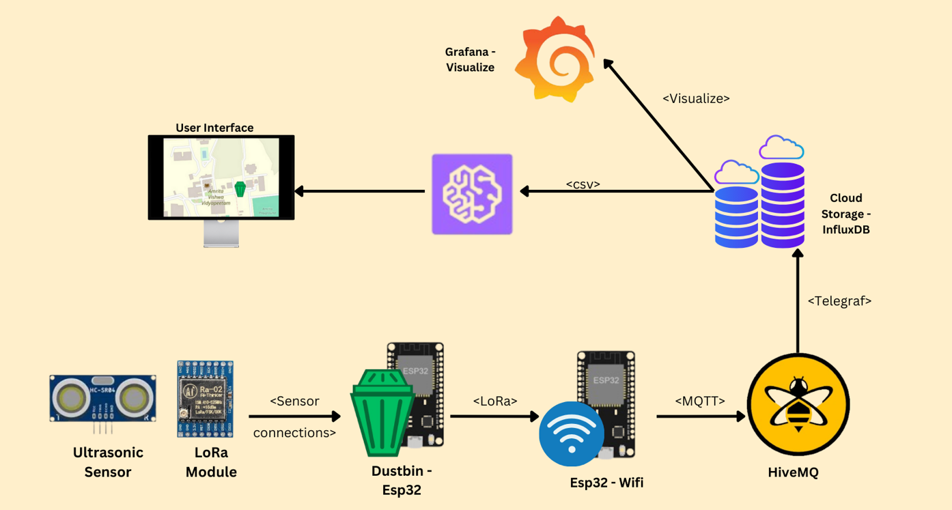
Software Design

Slide 9
Software Design
Initialization
Network Connection
Data Handling
Packet Transmission
Initialize the LoRa communication module, set up pins and parameters, and establish the communication protocol.
Connect to the LoRa network, configure the module with network settings, and join the network for data transmission.
Read data from the ultrasonic sensor, convert the data to the required format, and prepare a LoRa packet for transmission.
Send the prepared LoRa packet containing sensor data to the gateway ESP32 for further processing and wait for acknowledgment.
Initialized LoRa communication module
Set up pins and parameters
Established communication protocol
Connected to LoRa network
Configured network settings
Joined the LoRa network
Read sensor data
Converted data to desired format
Prepared LoRa packet for transmission
Sent LoRa packet to gateway
Waited for acknowledgment

Slide 10
Integration of End, Edge, and Cloud
End devices are responsible for data collection using sensors like Ultrasonic Sensors. These devices are deployed at the point of interest, such as waste bins, to monitor fill levels. They gather real-time data on the bin’s status, which is then transmitted to edge devices or directly to the cloud for further processing and analysis. End devices are typically designed to be energy-efficient, robust, and capable of operating in various environmental conditions to ensure continuous and reliable data collection.
End Devices (Waste Bin ESP32)
Edge Devices (Gateway ESP32)
Edge devices process this data and send it to the cloud for analysis and storage.Gateway devices, part of the edge network, receive data from end devices via LoRa and transmit it to the cloud using Wi-Fi and MQTT for analysis and visualization.
Cloud Infrastructure (HiveMQ Cloud,InfluxDB)
The cloud infrastructure, specifically HiveMQ Cloud, receives and processes data from edge devices. It provides storage, analytics, and dashboard interfaces for real-time monitoring.

Slide 11
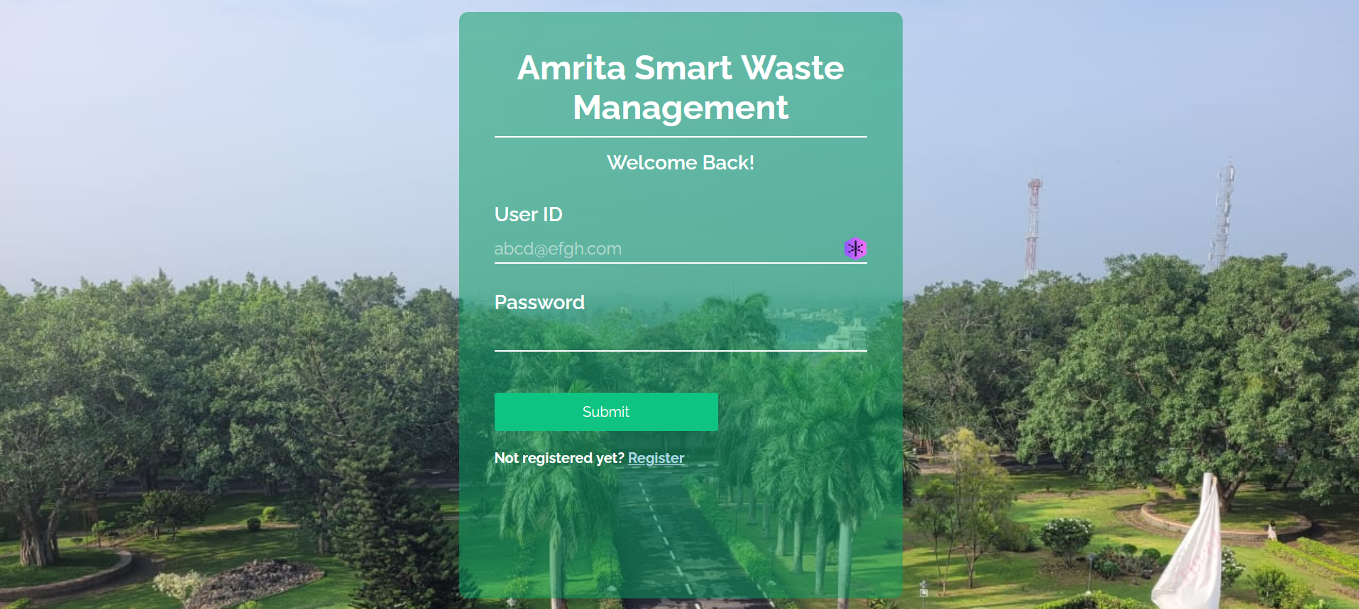
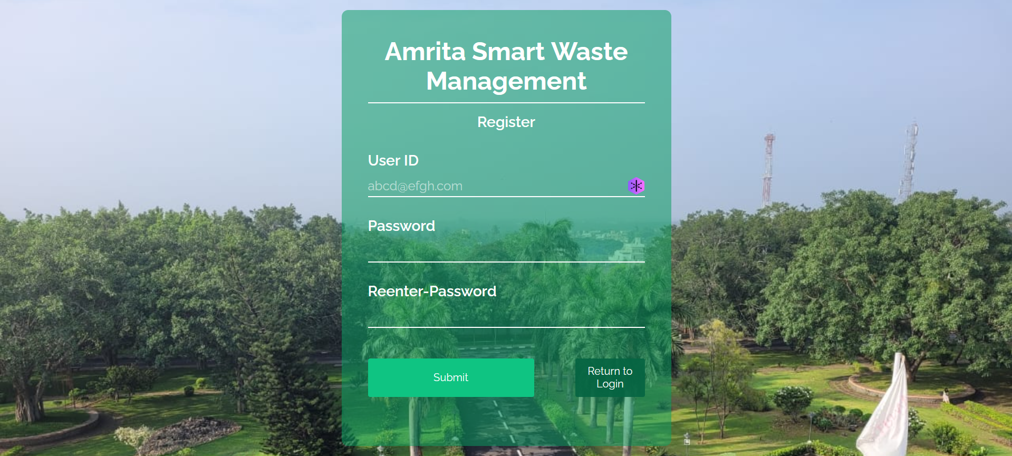
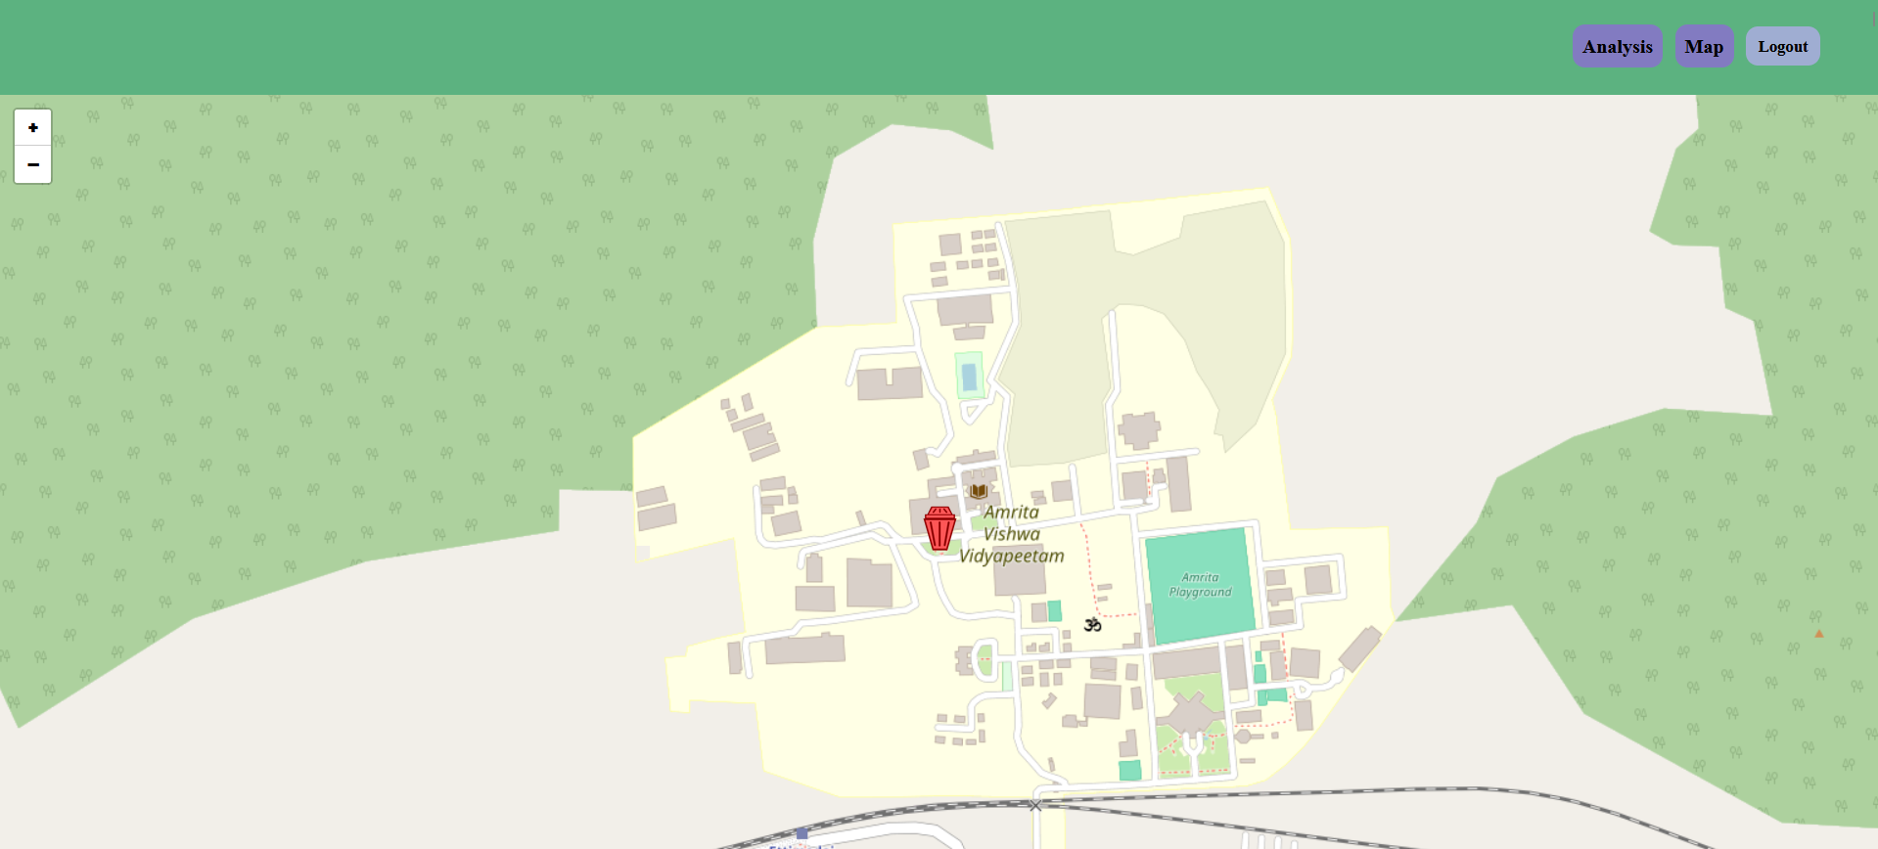
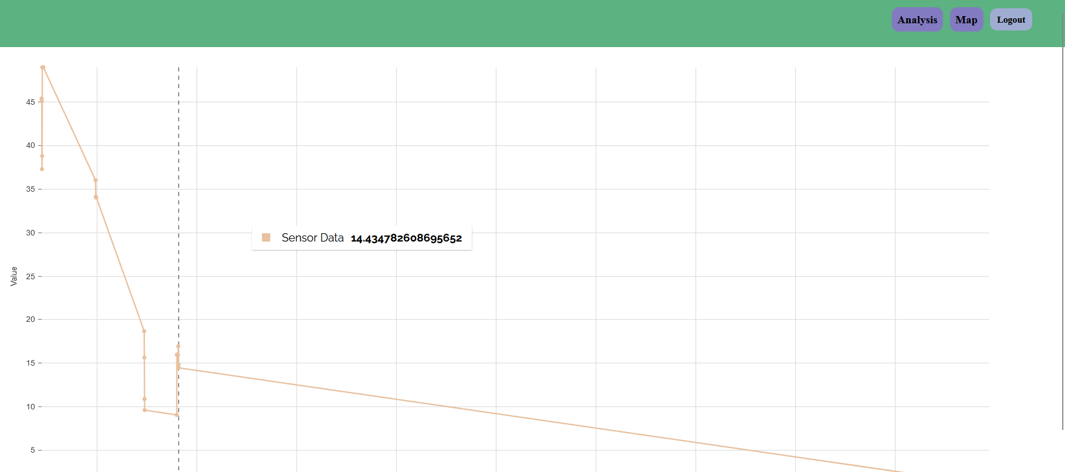
User Interface
Login
Signup
Map
Analysis

Slide 12
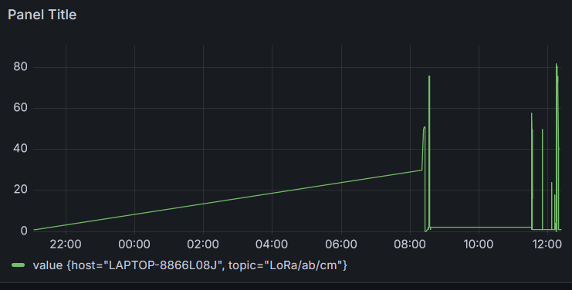
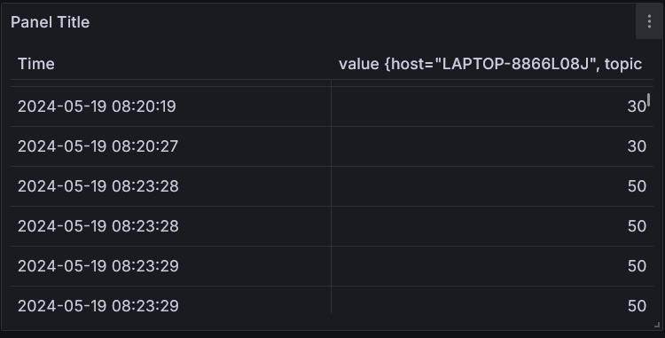
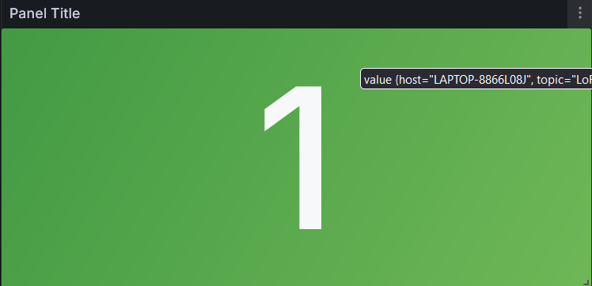
Grafana Interface
Line plot
Table
Stat

Slide 13
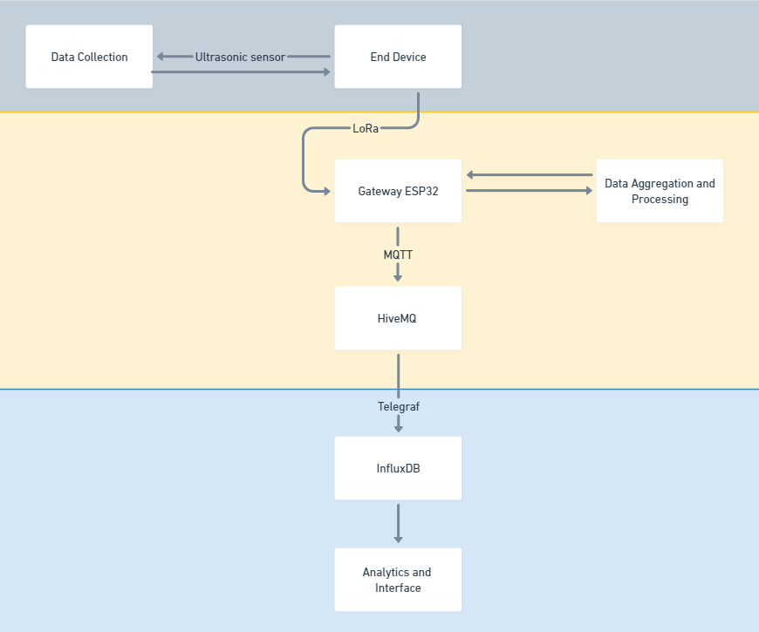
Integration of End, Edge, and Cloud

Slide 14
Data Accumulation and Processing
Data Accumulation
Data Processing
Data is collected from the waste bins by the end devices (Waste Bin ESP32) using ultrasonic sensors.
Real-time data processing is performed at the edge to ensure timely responses and efficient waste management.
Data is transmitted to the cloud infrastructure for further analysis and decision-making.
Edge devices (Gateway ESP32) receive and process the data from the waste bins, preparing it for cloud transmission.
The cloud infrastructure stores the data for historical analysis and processes it to identify patterns and optimize waste collection routes.
An analytics engine provides insights for data-driven decision-making, improving overall waste management efficiency.

Slide 15
IoT Analytics and Outcomes
Through real-time monitoring, data analysis, and predictive maintenance, our smart waste management project aims to enhance efficiency, reduce costs, promote environmental sustainability, and improve decision-making for optimized waste collection routes and schedules.
Significant reduction in operational costs
Efficiency
Improved waste management practices
Sustainability
Implemented predictive waste levels analysis
Data Analytics

Slide 16
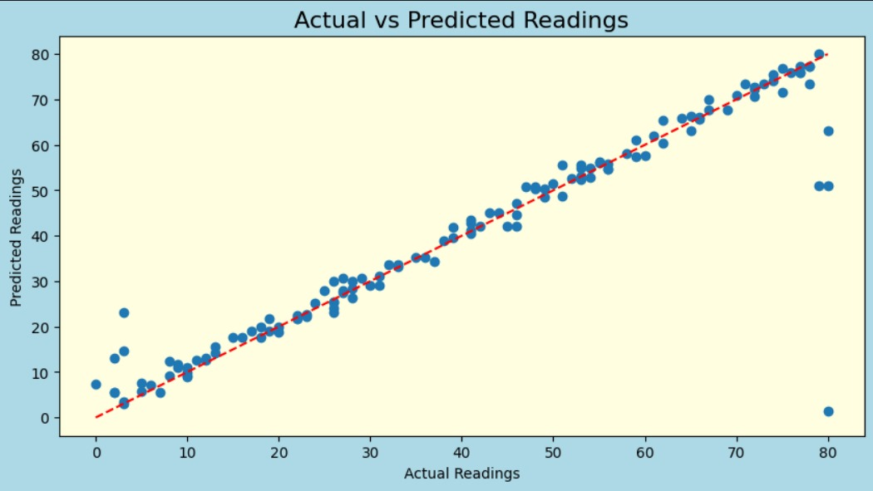
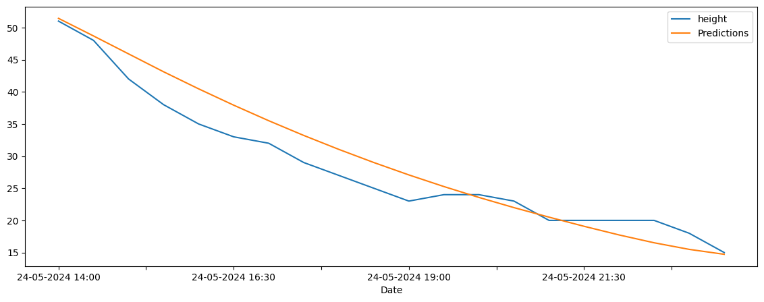
IoT Analytics and Outcomes
Prediction: Both Random Forest and LSTM models were used to make predictions on new data.
Visualization: Predicted data was visualized using tools like Matplotlib to provide insights into waste trends and future levels.

Slide 17
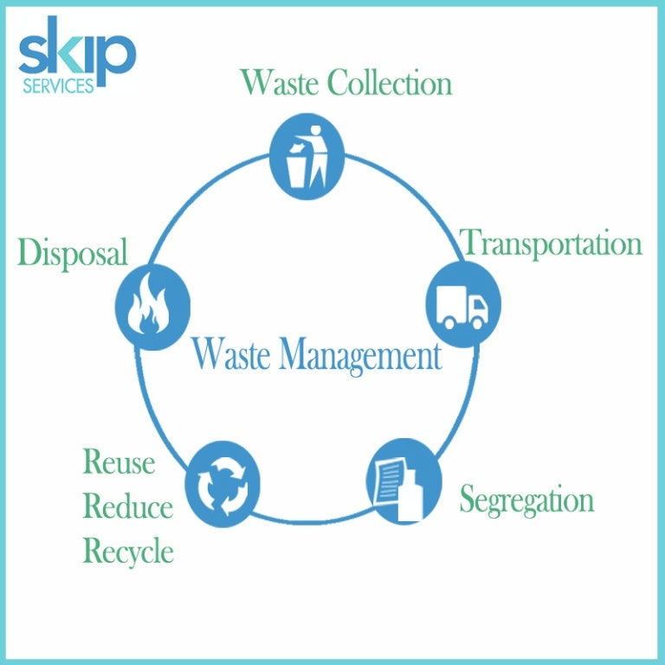
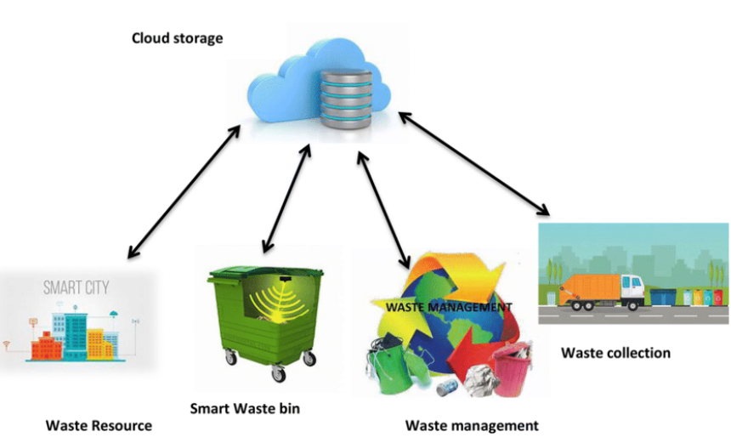
Conclusion and Future Scope
Integration with additional sensors and IoT devices to enhance data collection and analysis capabilities.
Development of predictive analytics models for more accurate forecasting of waste generation and fill levels.
Expansion of the system to cover a larger geographic area or additional types of waste.
Implementation of machine learning algorithms for anomaly detection and optimization of waste collection routes.
Collaboration with local authorities and waste management agencies for broader adoption and scaling of the solution.
Successful implementation of a smart waste management system leveraging IoT technology.
Improved efficiency and cost-effectiveness in waste collection and management processes.
Real-time monitoring and data analytics have enhanced decision-making and operational effectiveness.
Positive impact on environmental sustainability through optimized waste collection practices.
Enhanced user experience and stakeholder satisfaction with timely and efficient waste management services.

Slide 18
Reference
https://www.hivemq.com/blog/integrating-esp32-lorawan-hivemq-mqtt-broker-advanced-iot/
https://airb.in/

